Slide 1
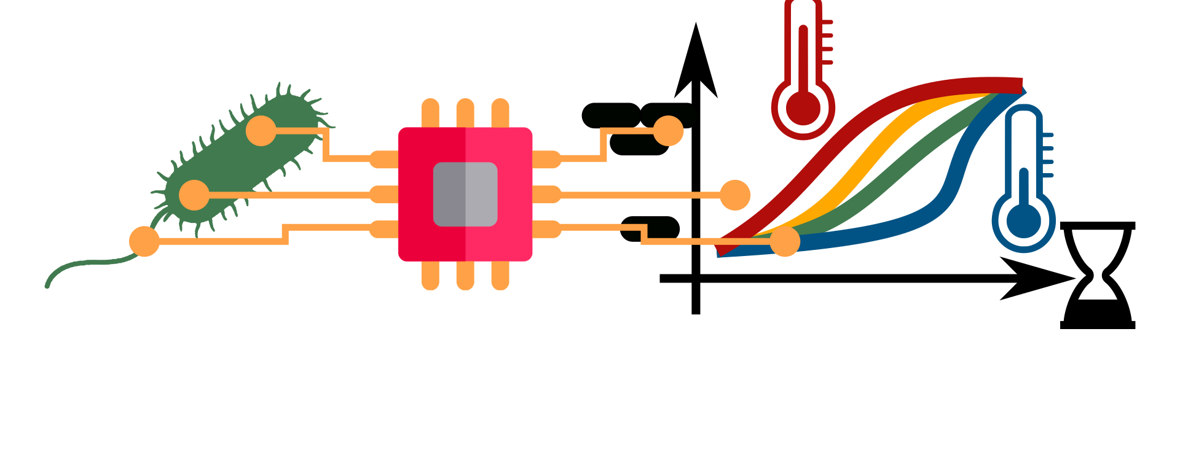
GenScaleSim: Simulation of Genome Scale Metabolic Models
The BioLabSim.nrw consortium

Slide 2
Content
Genome-scale models
Structure
Hands on tutorial
FBA with Jupyter Notebooks

Slide 3
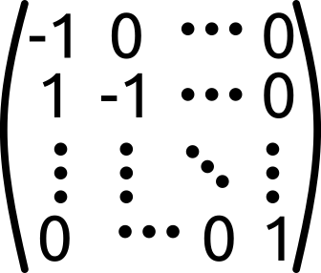
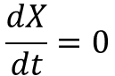
Learning Objectives
You can name the key component of a genome scale metabolic network.
You can convert chemical reaction notation into stoichiometric matrices.
You can name the fundamental assumptions of constraint based model simulations.
Glc + ATP -> Glc6P + ADP
$$\frac{dX}{dt}=0$$

Slide 4
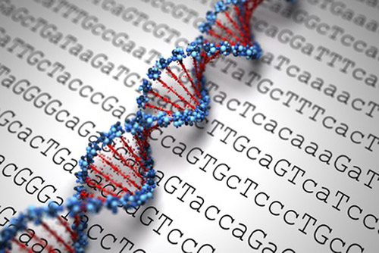
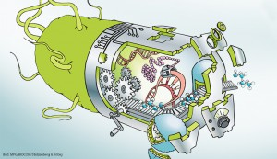
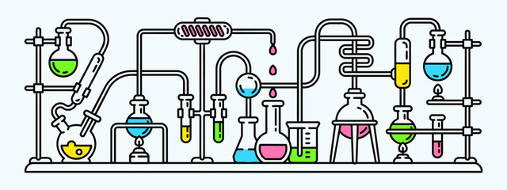
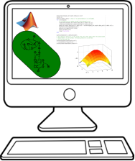
Modeling and Simulation in Biotechnologie?
High throughput sequencing is rapid and cheap.
Genome sequencing catalogues a large part of the enzymatic composition of microorganisms.
Experiments are overall time consuming and expensive and naive functions expectations can be misleading.
New metabolic capacities are engineered by manipulating the enzymatic composition.
Computer based simulation of metabolism:
Identification of genetic modifications for efficient target substance production.
Rapid and cheap hypothesis cycles.
Highly reproducible and automatable.

Slide 5
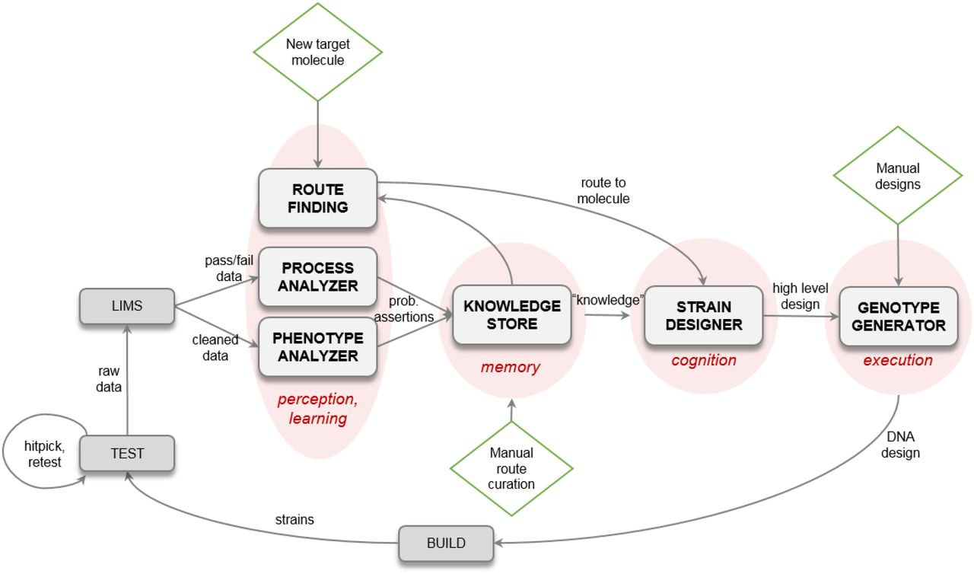
Example: Automated strain development by Amyris
Amyris is an innovative California-based biotech company (600 employees).
Strain development for market scale in tons of product requires many steps with dedicated experts.
Strain development is expensive ($100-$200 M) and time consuming (>10 years).
Construction of a automated workflow to design and test molecules and pathways for industrial upscaling.
Part of the automated workflow: metabolic flux prediction for effectiv genetic manipulation.
Singh et al., 2023. An Automated Scientist to Design and Optimize Microbial Strains for the Industrial Production of Small Molecules, bioRxiv, https://doi.org/10.1101/2023.01.03.521657

Slide 6
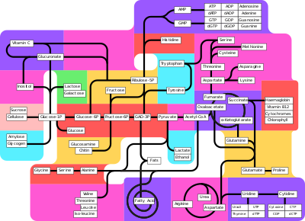



From sequence to metabolic network
Annotation
Gapfilling (automatisch/manuell)
Sequenzierung
Rekonstruktion
Intensive manuelle Arbeit um realistische metabolische Kapazität zu reproduzieren.
https://www.flaticon.com/free-icons/protein

Slide 7
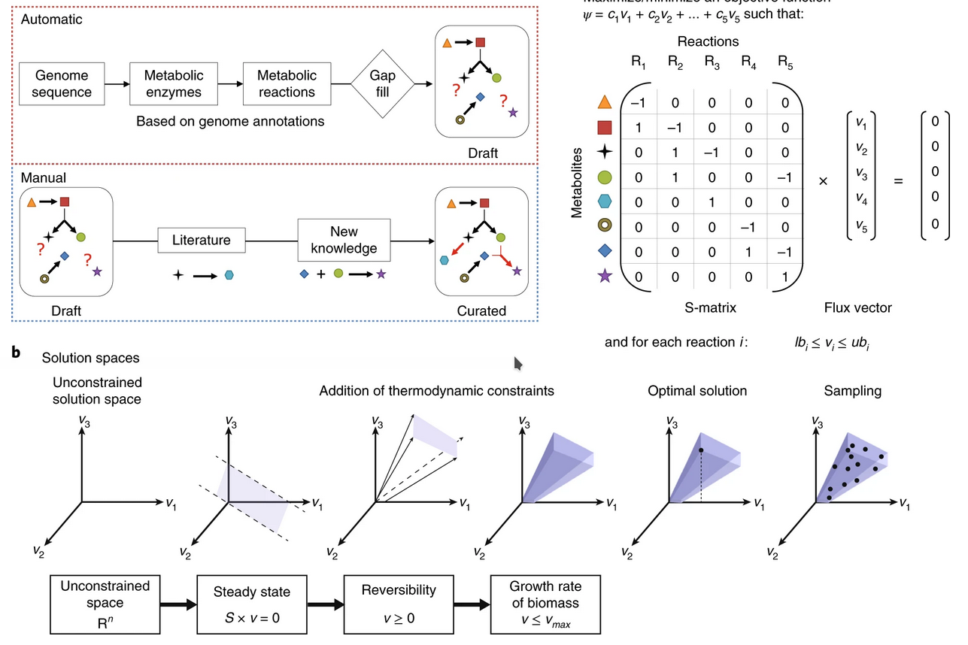
From metabolic network to stoichiometric matrix
The stroichiometric matrix is the key element of each GSMM.
The matrix is multiplied by the flux of each reaction.
R₁
R₅
Metabolite concentrations remain constant:
steady state assumption
Metabolites are on the rows, reactions on the columns.
Heirendt et al., 2019, doi: 10.1038/s41596-018-0098-2

Slide 8
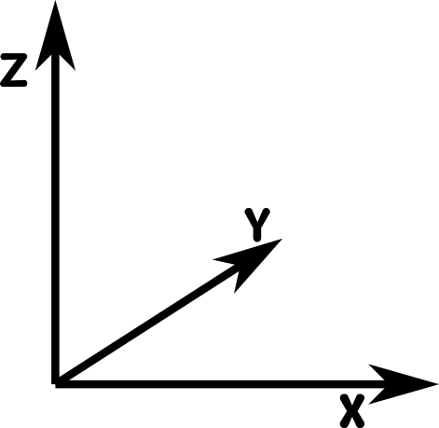
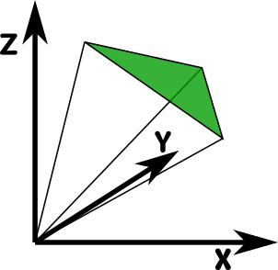
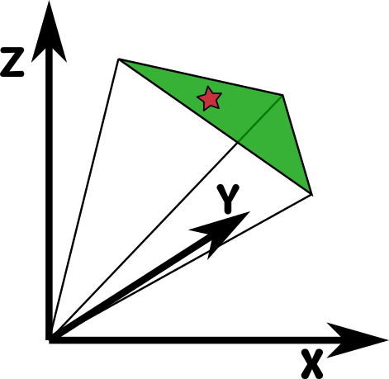
From stoichiometric matrix to flux distribution
The equation system has more unknown variables (fluxes) than equations (metabolite balances)
Maximize flux of one reaction
(target function optimization):
typically biomass equation for growth
products for maximal yield calculations (e.g. succinate)
Constrain flux range:
Mass balance
Limited substrate uptake rate constrains total carbon flux.
ATP turn-over as house keeping metabolism
Optimal flux distribution

Slide 9
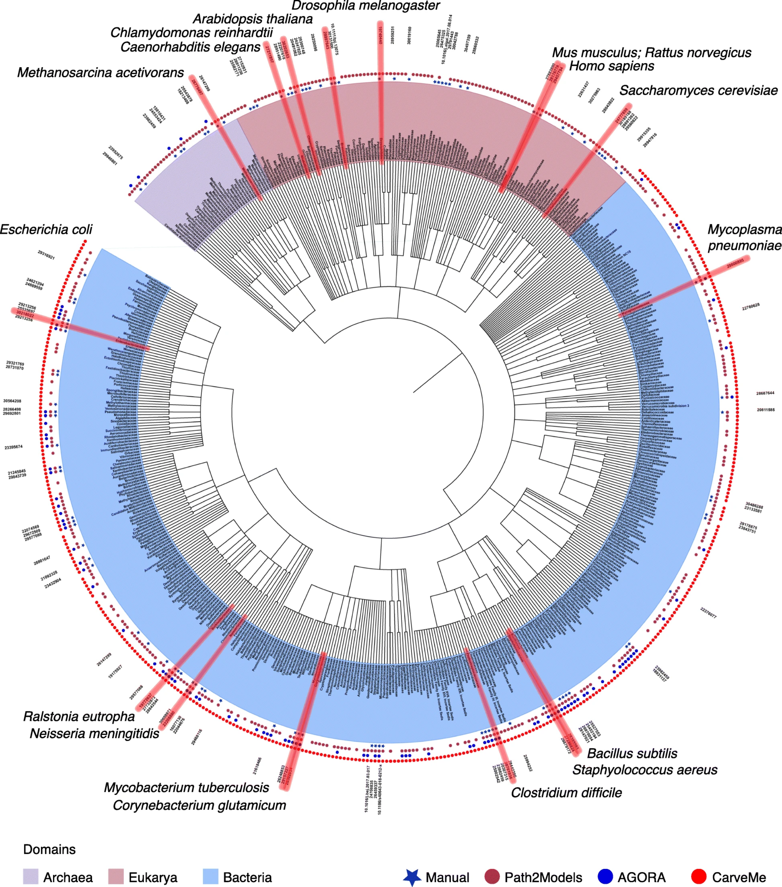
Genome-scale Network Reconstructions: Huge phylogenetic coverage
183 manually curated species
across the tree of life
There are thousands of automated metabolic reconstructions derived from metabolic repositories (e.g. KEGG - Kyoto Enzyclopedia Genes and Genomes).
About 200 GSMMs are manually curated and with experimental data validated.
Model organisms typically have a high quality GSMM for simulations.
Gu et al., 2019. 10.1186/s13059-019-1730-3

Slide 10
Size of GEMs
Helicobacter pylori:
iIT341
485 metabolites
554 reactions
339 genes
(21% of predicted genes)
Escherichia coli: iML1515
1877 metabolites
2712 reactions
1515 genes (35% of predicted genes)
Pseudomonas putida KT2440
iJN746
907 metabolites
1054 reactions
746 genes (14% of predicted genes)
S. cerevisiae: yeastGEM
2691 metabolites
3963 reactions
1139 genes
Mus musculus iMM1415 2775 metabolites
3726 reactions
1375 genes
Homo Sapiens
Recon3D
4140 unique metabolites
13543 reactions
3288 genes
(17% of functionally annotated human genes)
Repositories: BiGG database: http://bigg.ucsd.edu
EMBL-EBI Biomodels DB: https://www.ebi.ac.uk/biomodels-main/

Slide 11

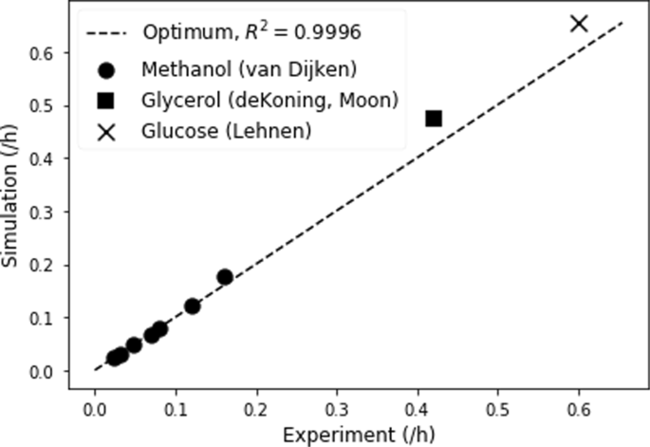
O. polymorpha: Overlap of experiment and simulation
Growth experiments with different substrates and growth rates.
Simulation of optimal growth based on constraints from growth experiments.
Very good predictive power of the GSMM O. polymorpha (Liebal et al., 2021).
Liebal et al., 2021, doi: 10.1186/S12896-021-00675-W
Bioicons.com

Slide 12
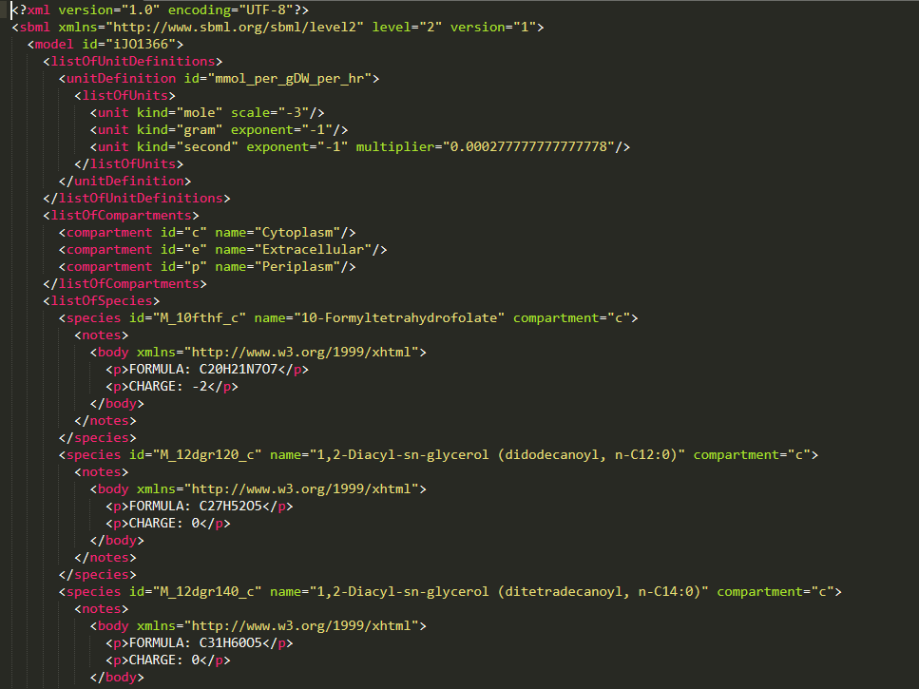
Common model format: SBML Systems Biology Mark-up Language
SBML is a machine-readable format for representing models.
widely accepted and used by the metabolic modeling community
→ Compatible w/ most modeling tools

Slide 13
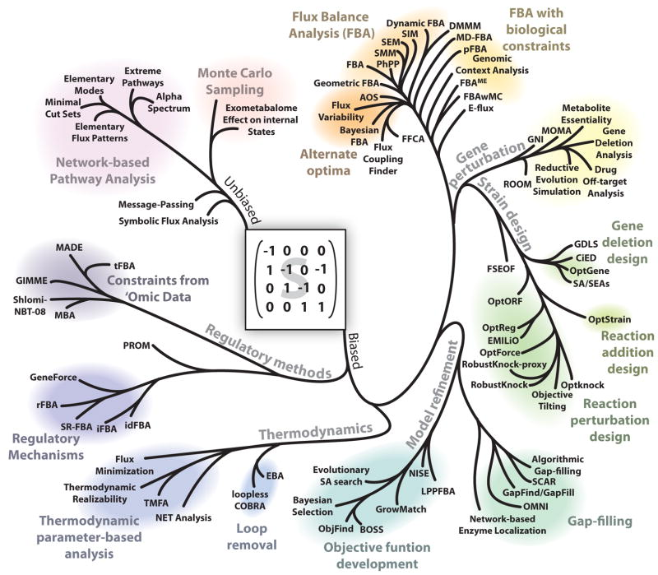
A phylogeny of modeling methods
Lewis N et al. Nat Rev Microbiol. 2012 Feb 27; 10(4): 291–305.

Slide 14


Software tools for simulation of GSMM
COBRA: Constraint-based Reconstruction and Analysis
RAVEN: Reconstruction, Analysis and Visualization of Metabolic Networks
Available for Python and Matlab
Very popular
Community based software development
Best use for model analysis and metabolic engineering
git Link:
https://github.com/opencobra/cobrapy
Reference: Heirendt et al., 2019, doi: 10.1038/s41596-018-0098-2
Available for Matlab
Well known
Software development through dedicated groups
Optimal support for model reconstruction
git Link:
https://sysbiochalmers.github.io/RAVEN/
Reference: Wang et al., 2018, doi: 10.1371/journal.pcbi.1006541
Heirendt et al., 2019, doi: 10.1038/s41596-018-0098-2

Slide 15
How to work with COBRApy models?
model.metabolites.nadh_c.summary()
Get a summary of the entity 'nadh_c' from the subclass 'metabolites' in the class 'model' by calling the method 'summary()'
solution = model.optimize()
Optimize (run an FBA) on the model

Slide 16
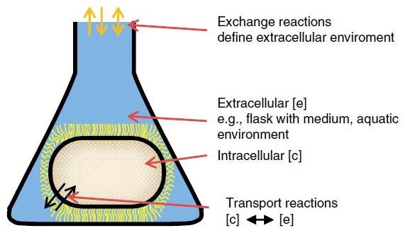
iJO1366: E. coli GEM
Compartments:
e extracellular
c cytosol
p periplasma
Definition of exchange reactions: metab_e <=>
Phosphate exchange: pi_e <=>
Phosphate transport via diffusion (extracellular to periplasm)
pi_e <=> pi_p
Phosphate transport via ABC system (uptake, periplasm)
atp_c + h2o_c + pi_p -> h_c + adp_c + 2 pi_c

Slide 17
Biomass synthesis reaction
Lumped biomass equation used in previous lectures:
Genome-scale models allow a bit more detail:
0.000223 10fthf[c] + 0.000223 2ohph[c] + 0.5137 ala-L[c] + 0.000223 amet[c] + 0.2958 arg-L[c] + 0.2411 asn-L[c] + 0.2411 asp-L[c] + 59.984 atp[c] + 0.004737 ca2[c] + 0.004737 cl[c] + 0.000576 coa[c] + 0.003158 cobalt2[c] + 0.1335 ctp[c] + 0.003158 cu2[c] + 0.09158 cys-L[c] + 0.02617 datp[c] + 0.02702 dctp[c] + 0.02702 dgtp[c] + 0.02617 dttp[c] + 0.000223 fad[c] + 0.007106 fe2[c] + 0.007106 fe3[c] + 0.2632 gln-L[c] + 0.2632 glu-L[c] + 0.6126 gly[c] + 0.2151 gtp[c] + 54.462 h2o[c] + 0.09474 his-L[c] + 0.2905 ile-L[c] + 0.1776 k[c] + 0.01945 kdo2lipid4[e] + 0.4505 leu-L[c] + 0.3432 lys-L[c] + 0.1537 met-L[c] + 0.007895 mg2[c] + 0.000223 mlthf[c] + 0.003158 mn2[c] + 0.003158 mobd[c] + 0.01389 murein5px4p[p] + 0.001831 nad[c] + 0.000447 nadp[c] + 0.011843 nh4[c] + 0.02233 pe160[c] + 0.04148 pe160[p] + 0.02632 pe161[c] + 0.04889 pe161[p] + 0.1759 phe-L[c] + 0.000223 pheme[c] + 0.2211 pro-L[c] + 0.000223 pydx5p[c] + 0.000223 ribflv[c] + 0.2158 ser-L[c] + 0.000223 sheme[c] + 0.003948 so4[c] + 0.000223 thf[c] + 0.000223 thmpp[c] + 0.2537 thr-L[c] + 0.05684 trp-L[c] + 0.1379 tyr-L[c] + 5.5e-005 udcpdp[c] + 0.1441 utp[c] + 0.4232 val-L[c] + 0.003158 zn2[c] → 59.81 adp[c] + 59.81 h[c] + 59.806 pi[c] + 0.7739 ppi[c]

Slide 18
Content
Genome-scale models
Structure
Hands on tutorial
FBA with Jupyter Notebooks

Slide 19

Authors and License
BioLabSim.nrw members at:
https://git.rwth-aachen.de/ulf.liebal/biolabsim/-/blob/master/AUTHORS.md
Main authors: Dr. Ulf Liebal, Prof. Dr. Lars Blank
The construction of slides was supported by Dr. Birgitta Ebert.
All material in this lecture is free to use, adapt and distribute according to CC BY 4.0 citing:
Ulf Liebal, BioLabSim.nrw consortium, GenScaleSim Lecture, 2024, https://git.rwth-aachen.de/ulf.liebal/biolabsim

